Slide 1
Database Characterization Report using R
Lucas Galvão Janot
CEUB
June 19, 2023
Chembl Database

Slide 2
Introduction
Chosen Database: Chembl.
Contains information about bioactive molecules and their properties.
The database can be found at the following URL: https://www.ebi.ac.uk/chembl/. More than 2 million distinct records.
Widely used in drug development and medicinal chemistry research.
Chembl Database

Slide 3
Database Information
Database: ChEMBL Release date: Oct 2009
Latest version date: Jan 2023
Maintainer: European Bioinformatics Institute, European Molecular Biology Laboratory (EMBL-EBI).
Objective: To provide a comprehensive, freely accessible resource of bioactive molecules with drug-like properties and their associated biological activities for drug discovery and development purposes.
Chembl Database

Slide 4
Variables used for the analysis
ChEMBL ID: Unique identifier for each compound entry
Name: Name of the molecule
SMILES: Simplified Molecular Input Line Entry System
Molecular Formula: Representation of the molecule’s composition
Molecular Weight: Mass of the molecule
ALogP: Partition coefficient (logP) in aqueous solution NumHAcceptors: Number of hydrogen bond acceptor sites NumHDonors: Number of hydrogen bond donor sites NumRotatableBonds: Number of bonds that can rotate freely RingCount: Number of rings present in the molecule
TPSA: Topological Polar Surface Area
Type: Classification of the molecule based on its chemical structure and characteristics.
Chembl Database

Slide 5
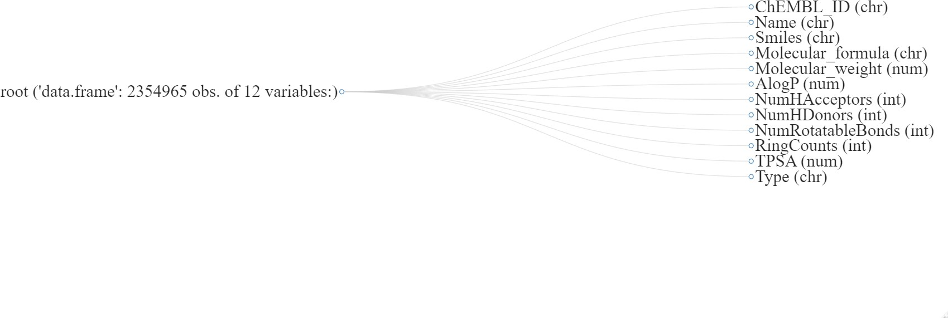
Variables Tree
Chembl Database

Slide 6
Variables Summary
ChEMBL ID:
Length: 2,354,965 Class: Character Mode: Character NA’s: 0
Name:
Length: 2,354,965 Class: Character Mode: Character
NA’s: 2,306,892 (≈ 97.96%)
SMILES:
Length: 2,354,965 Class: Character Mode: Character NA‘s: 0
Molecular Formula: Length: 2,354,965 Class: Character
Mode: Character
NA‘s: 0
Chembl Database

Slide 7
Variables Summary (contd.)
Molecular Weight:
Min.: 4.0 (CHEMBL1796997, Name:
Undefined, He , Small Molecule)
1st Qu.: 324.4
Median: 392.4
Mean: 433.9
3st Qu.: 474.5
Max.: 12546.3 (CHEMBL2179464, Name:
Undefined, C396 H390 F252 N66 O24 P42 , Small Molecule)
NA‘s: 23,442 (≈ 1%)
ALogP:
Min.: -14.26 (CHEMBL1797815, Name: CELLOHEXOSE, C36 H62 O31 , Small
Molecule)
1st Qu.: 2.31
Median: 3.42
Mean: 3.45
3st Qu.: 4.57
Max.: 22.57 (CHEMBL1206998, Name:
Undefined C64 H127 NO3 S, Small Molecule)
NA‘s: 84,994 (≈ 3.61%)
Chembl Database

Slide 8
Variables Summary (contd.)
NumHAcceptors:
Min.: 0.0 (CHEMBL425822, Name:
Undefined, C36 H62 O31 , Small Molecule)
1st Qu.: 4.0
Median: 5.0
Mean: 5.5
3st Qu.: 6.0
Max.: 32 (CHEMBL604420, Name:
Undefined, C24 H16 F6 , Small Molecule)
NA‘s: 84,994 (≈ 3.61%)
NumHDonors:
Min.: 0.0 (CHEMBL149936, Name:
Undefined, C21 H18 N2 O4 S2 , Small Molecule)
1st Qu.: 1.0
Median: 1.0
Mean: 1.59
3st Qu.: 2.0
Max.: 25 (CHEMBL1162334, Name:
GUANIDINONEOMYCIN, C29 H58 N18 O13 ,
Small Molecule)
NA‘s: 84,994 (≈ 3.61%)
Chembl Database

Slide 9
Variables Summary (contd.)
NumRotatableBonds:
Min.: 0.0 (CHEMBL373674, Name:
Undefined, C12 H10 N2 O , Small Molecule)
1st Qu.: 3.0
Median: 5.0
Mean: 5.73
3st Qu.: 7.0
Max.: 67 (CHEMBL541380, Name:
Undefined, C56 H129 ClN14 , Small Molecule)
NA‘s: 84,994 (≈ 3.61%)
RingCount:
Min.: 0.0 (CHEMBL409633, Name:
Undefined, C74 H12 O , Small Molecule)
1st Qu.: 2.0
Median: 2.0
Mean: 2.46
3st Qu.: 3.0
Max.: 30 (CHEMBL409633, Name:
Undefined, C74 H12 O, Small Molecule)
NA‘s: 84,994 (≈ 3.61%)
TPSA:
Min.: 0.0 (CHEMBL425822, Name:
Undefined, C24 H16 F6 , Small Molecule)
1st Qu.: 54.88
Median: 75.21
Mean: 81.87
3st Qu.: 99.27
Max.: 595.22 (CHEMBL32709, Name:
Undefined, C36 H74 N24 O7 , Protein)
NA‘s: 84,994 (≈ 3.61%)
Chembl Database

Slide 10
Variables Summary (contd.)
Type:
Length: 2,354,965 Class: Character Mode: Character NA‘s: 0
Proportions:
Small Molecules: 1,920,599 (≈ 81.555%)
Unknown: 409,991 (≈ 17.41%)
Protein: 22,750 (≈ 0.966%)
Oligosaccharide: 95 (≈ 0.004%)
Oligonucleotide: 201 (≈ 0.009%)
Gene: 107 (≈ 0.005%)
Enzyme: 121 (≈ 0.005%)
Cell: 55 (≈ 0.002%)
Antibody: 1046 (≈ 0.044%)
Chembl Database

Slide 11
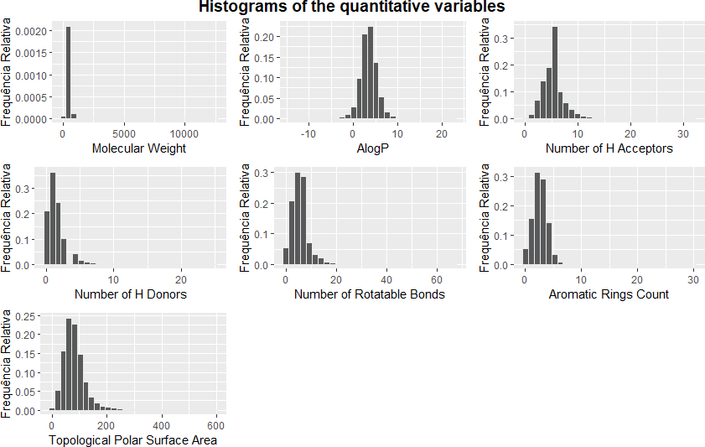
Histograms
Chembl Database

Slide 12
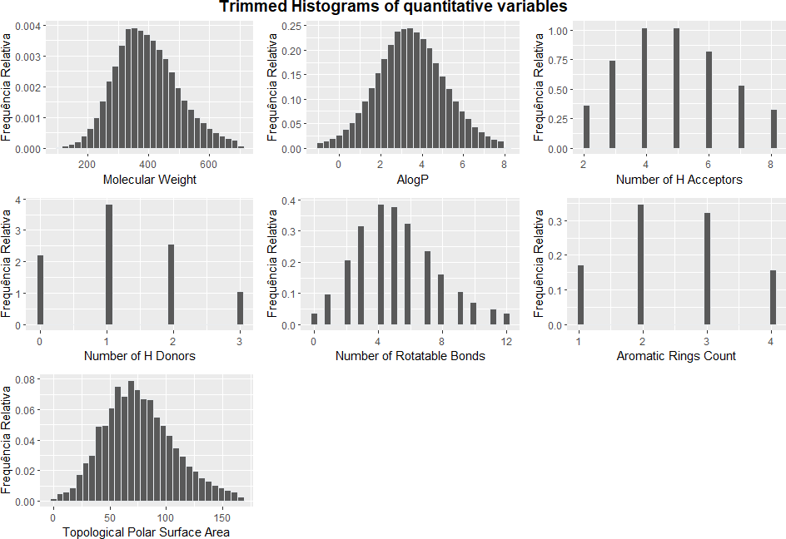
Histograms (contd.)
Chembl Database

Slide 13
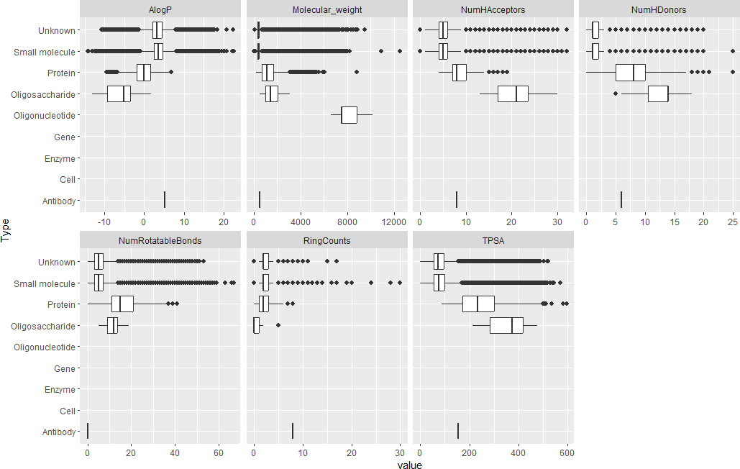
Boxplot
Chembl Database

Slide 14
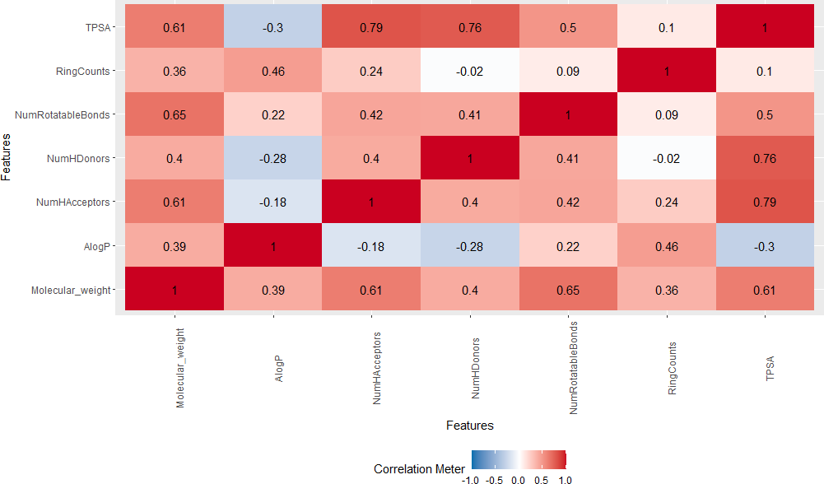
Correlation Matrix
Chembl Database

Slide 15
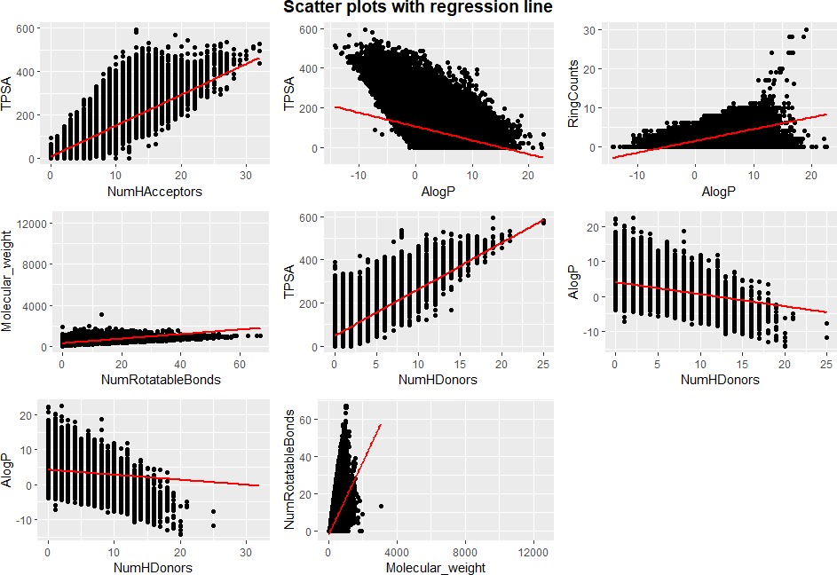
Scatter plots
Chembl Database

